Slide 1
SQL Server Transaction
Begin transaction
Commit
try/catch
rollback

Slide 2

Introduction to SQL server transaction
A transaction is a single unit of work that typically contains multiple T-SQL statements.
If a transaction is successful, the changes are committed to the database. However, if a transaction has an error, the changes have to be rolled back.
When executing a single statement such as INSERT, UPDATE, and DELETE, SQL Server uses the autocommit transaction. In this case, each statement is a transaction.

Slide 3
BEGIN TRANSACTION, COMMIT, ROLLBACK
To start a transaction explicitly, you use the BEGIN TRANSACTION or BEGIN TRAN statement first:
BEGIN TRANSACTION;
Then, execute one or more statements including INSERT, UPDATE, and DELETE.
Here’s the sequence of statements for starting a transaction explicitly and committing it:
(-- start a transaction)
BEGIN TRANSACTION;
-- other statements
-- commit the transaction
Finally, commit the transaction using the COMMIT statement:
COMMIT;
Code language: SQL (Structured Query Language) (sql)
Or roll back the transaction using the ROLLBACK statement:
ROLLBACK;

Slide 4

To implement a rollback in SQL Server you need two things:
Start a transaction with: BEGIN TRANSACTION.
Explicitly call ROLLBACK when something goes wrong.
Because you usually don’t know in advance whether something will fail, the common pattern is to wrap the work in a TRY…CATCH block.
Notes:
In this case think of a transaction as a ‘safe box’:
BEGIN TRANSACTION opens the box.
You make changes like updating balances.
COMMIT closes the box and saves everything.
ROLLBACK throws everything out if something goes wrong.
TRY…CATCH helps catch errors so the database stays correct and nothing is lost.

Slide 5
SQL Transactions: Commit, Rollback & Error Handling
Key Points
BEGIN TRANSACTION starts a unit of work that SQL Server treats as all-or-nothing.
COMMIT TRANSACTION makes all changes inside the transaction permanent.
ROLLBACK TRANSACTION undoes every change since the BEGIN TRANSACTION.
The TRY…CATCH block ensures that if any statement inside TRY raises a runtime error (constraint violation, deadlock, etc.), control moves to CATCH and you can roll back.
Notes:
BEGIN TRANSACTION starts a safe block, COMMIT saves changes, ROLLBACK undoes them if an error occurs, and TRY…CATCH ensures errors are handled so all changes succeed together or none do.

Slide 6
Example
STEP 1
CREATE DATABASE SCHOOL;
USE SCHOOL;
CREATE TABLE Accounts (
AccountID INT PRIMARY KEY,
AccountName NVARCHAR(100),
Balance DECIMAL(10,2)
);
INSERT INTO Accounts (AccountID, AccountName, Balance) VALUES
(1, 'Alice', 1000.00),
(2, ‘Bob, 500.00);
EXPECTED OUTPUT
AccountID | AccountName | Balance
---------------------------------
1 | Alice | 1000.00
2 | Bob | 500.00
Notes:
We create a database named SCHOOL, set up an Accounts table with an integer ID, a name, and a decimal balance, and add two initial accounts for Alice and Bob, which gives them starting money in the system.

Slide 7
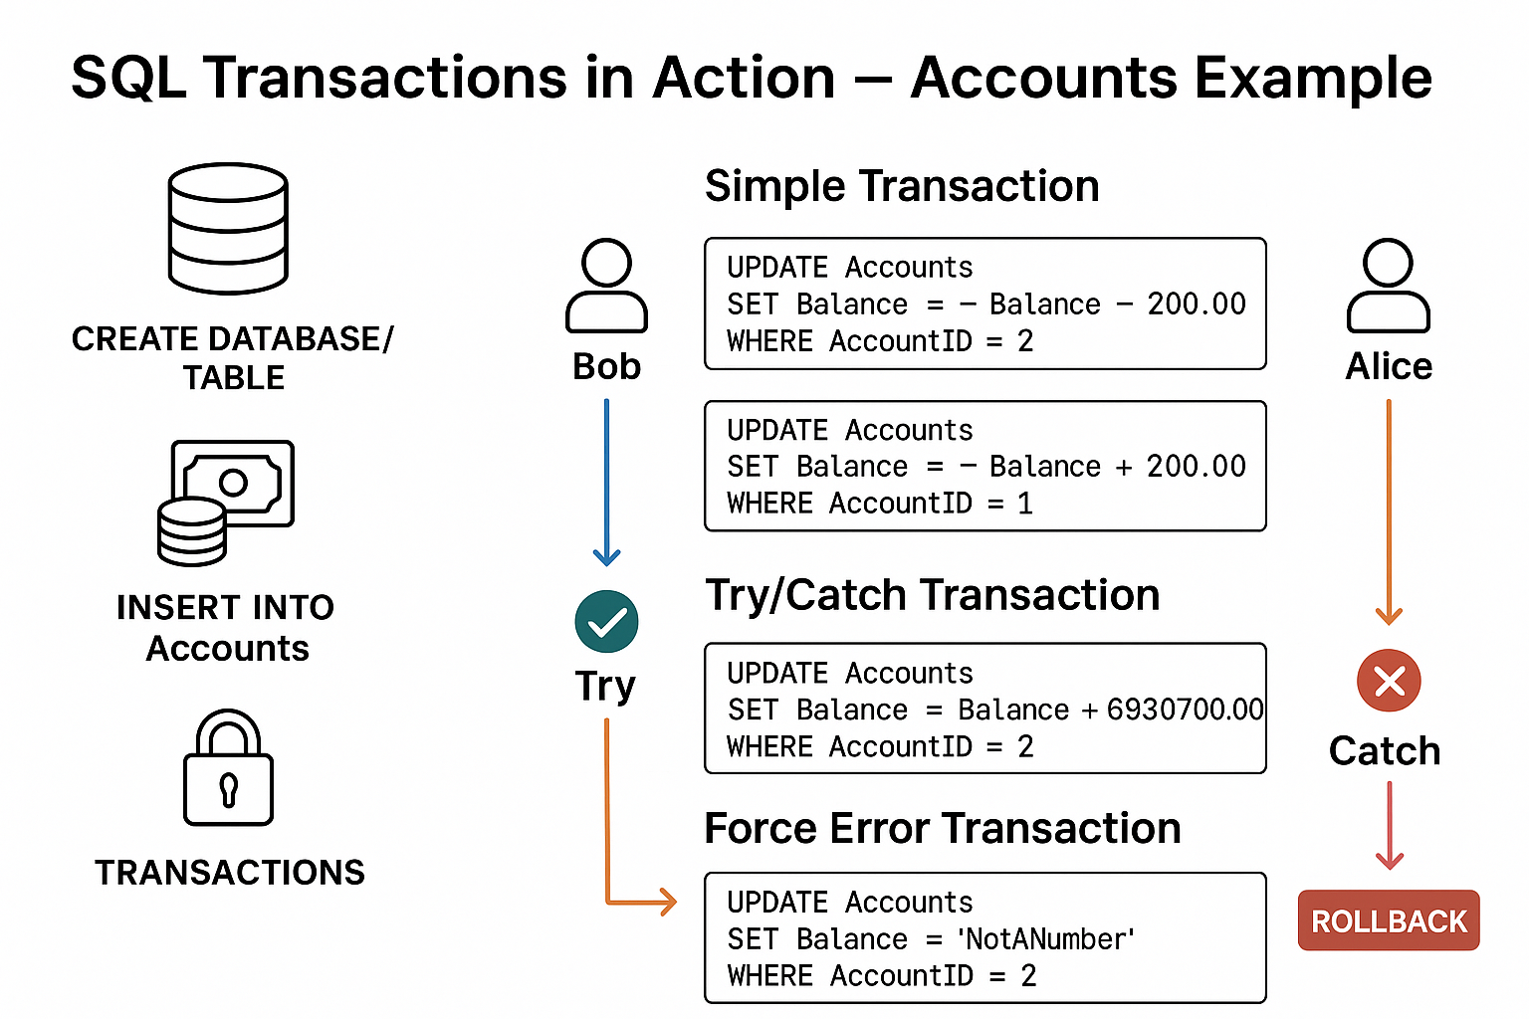

Slide 8
Commit
-- SIMPLE TRANSACTION: Move 200 from Bob to Alice
BEGIN TRANSACTION;
UPDATE Accounts
SET Balance = Balance - 200.00
WHERE AccountID = 2;
UPDATE Accounts
SET Balance = Balance + 200.00
WHERE AccountID = 1;
COMMIT TRANSACTION;
GO
SELECT * FROM Accounts;
GO
OUTPUT WILL BE
Alice = 1200.00
Bob = 300.00
Notes:
In this Case Bob gives Alice 200. And Because we commit, the new balances are permanently saved:

Slide 9

Commit with Error Handling (TRY…CATCH)
BEGIN TRANSACTION;
BEGIN TRY
UPDATE Accounts
SET Balance = Balance + 6930700.00
WHERE AccountID = 2;
UPDATE Accounts
SET Balance = Balance + 400.00
WHERE AccountID = 1;
COMMIT TRANSACTION;
SELECT * FROM Accounts;
END TRY
BEGIN CATCH
ROLLBACK TRANSACTION; -- Undo all changes if error occurs
DECLARE @ErrorMessage NVARCHAR(4000) = ERROR_MESSAGE(); -- Get error message
RAISERROR(@ErrorMessage, 16, 1); -- Show the error
END CATCH;
GO
Notes:
RAISERROR = “Display an error message.”
@ErrorMessage = the actual error text that happened in the TRY block.
16 = tells SQL Server it’s a normal error (not super serious).
1 = just a number for tracking where the error happened.
In short: It makes SQL Server tell you what went wrong when something fails inside the transaction.
Works together with ROLLBACK → undo changes and show the error.
If everything succeeds → COMMIT (changes saved).
If something fails → ROLLBACK (undo all changes, nothing saved).
For example: If the 6930700.00 overflows or violates rules → rollback will undo all updates.

Slide 10
Rollback Scenario
SELECT * FROM Accounts; -- (balances won't be affected because NotANumber is not an integer)
END TRY
BEGIN CATCH
ROLLBACK TRANSACTION; -- Undo changes
PRINT 'Rollback occurred: ' + ERROR_MESSAGE(); -- Show error
END CATCH;
GO
-- if rollback occured successfully then we expect balances from TRY/CATCH to display as the final balance on Alice and Bob's accounts
SELECT * FROM Accounts; -- Confirm final balances not affected
GO
-- FORCE ERROR TRANSACTION: insert text into number column
BEGIN TRANSACTION;
BEGIN TRY
UPDATE Accounts
SET Balance = 'NotANumber' -- Will probably fail because we defined our balance integers not text
WHERE AccountID = 2;
COMMIT TRANSACTION; -- Would save if no error
Notes:
Think of a transaction like moving money between two wallets:
Begin = Take both wallets in your hands.
Do Updates = Subtract from one, add to the other.
Commit = Seal the deal (permanent).
Rollback = Put wallets back as they were, like nothing happened.

